Slide 1


CoCo: Interactive Exploration of Conformance Constraints for Data Understanding and Data Cleaning
Anna Fariha, Ashish Tiwari, Alexandra Meliou, Arjun Radhakrishna, Sumit Gulwani
ACM SIGMOD/PODS International Conference on Management of Data
June, 2021

Slide 2

Example: Flights

Slide 3
Example: Flights
Departure Time | Arrival Time | Flight Duration | Distance Travelled | Arrival Delay

Slide 4



Constraints over flights
Departure Time | Arrival Time | Flight Duration | Distance Travelled | Arrival Delay
6:00
9:00
3 Hours
$$Arrival_Time− Departure_Time ≈Flight_Duration$$

Slide 5
Constraints over flights
Departure Time | Arrival Time | Flight Duration | Distance Travelled | Arrival Delay
$$Arrival_Time− Departure_Time ≈Flight_Duration$$
$$AIRCRAFT_SPEED × \left(Flight_Duration −Arrival_Delay\right) ≈Distance_Travelled$$

Slide 6
Conformance constraints:
a new data profiling primitive
$$Arrival_Time− Departure_Time ≈Flight_Duration$$
$$AIRCRAFT_SPEED × \left(Flight_Duration −Arrival_Delay\right) ≈Distance_Travelled$$
capture the invariants of the data
model linear arithmetic relationships involving multiple numerical attributes

Slide 7

Conformance constraints: general form
Projection
Lower bound
Upper bound

Slide 8
How to find good projections?
Find low-variance projections
Select projections with small mutual correlations
Use Principal Component Analysis (PCA)

Slide 9

Limitations of conformance constraints
$$0.003≤0.567 × Arrival_Time−0.567 × Departure_Time+0.23 × Flight_Duration−0.003 × Arrival_Delay+0.678 × Distance_Travelled≤0.005$$
Humans cannot easily process long inequalities
Not all attributes are relevant
Interpretable conformance constraints

Slide 10
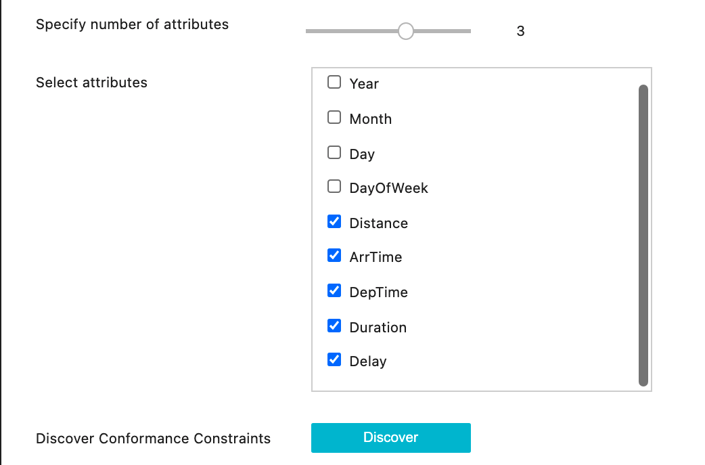
CoCo: interactive exploration of
Conformance Constraints

Slide 11

Demo

Slide 12
Can conformance constraints guide
us in data cleaning?
$$Arrival_Time− Departure_Time ≈Flight_Duration$$
Departure Time | Arrival Time | Flight Duration | Distance Travelled | Arrival Delay
9:00 | 11:00 | 21 hours | 1000 miles | 0

Slide 13
Can conformance constraints guide
us in data cleaning?
$$Arrival_Time− Departure_Time ≈Flight_Duration$$
Departure Time | Arrival Time | Flight Duration | Distance Travelled | Arrival Delay
9:00 | 11:00 | 2 hours | 1000 miles | 0

Slide 14
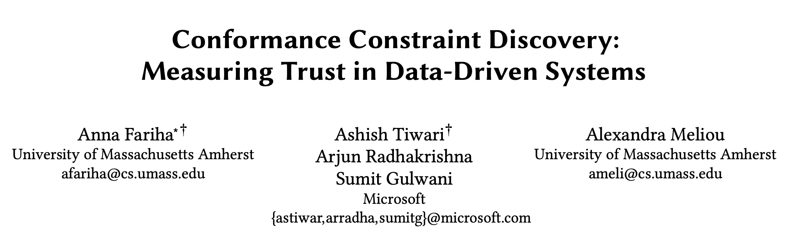

Key takeaways
Conformance constraint is a new data profiling primitive to model linear arithmetic relationships among numerical data attributes.
Conformance constraints help in data understanding
and can guide in data cleaning.
Full Paper
[SIGMOD 2021]
Anna Fariha <afariha@cs.umass.edu>

